Slide 1
Data Mining and Data Warehousing
CSE-4107
Md. Manowarul Islam
Assistant Professor, Dept. of CSE
Jagannath University

Slide 2
Correlation

Slide 3
Correlation
A correlation is a relationship between two variables. The data can be represented by the ordered pairs (x, y) where x is the independent (or explanatory) variable, and y is the dependent (or response) variable.
A scatter plot can be used to determine whether a linear (straight line) correlation exists between two variables.
y
2
x
Example:
2
4
6
x | 1 | 2 | 3 | 4 | 5
y | – 4 | – 2 | – 1 | 0 | 2
–2
– 4

Slide 4
Linear Correlation
y
y
As x increases, y tends to decrease.
As x increases, y tends to increase.
x
x
Negative Linear Correlation
Positive Linear Correlation
y
y
x
x
No Correlation
Nonlinear Correlation

Slide 5
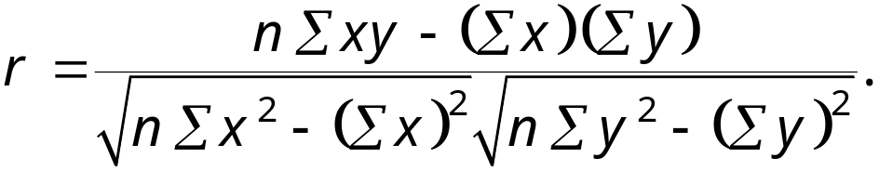
Correlation Coefficient
The correlation coefficient is a measure of the strength and the direction of a linear relationship between two variables. The symbol r represents the sample correlation coefficient. The formula for r is
The range of the correlation coefficient is −1 to 1. If x and y have a strong positive linear correlation, r is close to 1. If x and y have a strong negative linear correlation, r is close to −1. If there is no linear correlation or a weak linear correlation, r is close to 0.

Slide 6
Linear Correlation
y
y
r = −0.91
r = 0.88
x
x
Strong negative correlation
Strong positive correlation
y
y
r = 0.42
r = 0.07
x
x
Weak positive correlation
Nonlinear Correlation

Slide 7





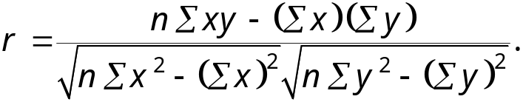
Calculating a Correlation Coefficient
Calculating a Correlation Coefficient
In Words In Symbols
Find the sum of the x-values.
Find the sum of the y-values.
Multiply each x-value by its corresponding y-value and find the sum.
Square each x-value and find the sum.
Square each y-value and find the sum.
Use these five sums to calculate the correlation coefficient.
Continued.

Slide 8





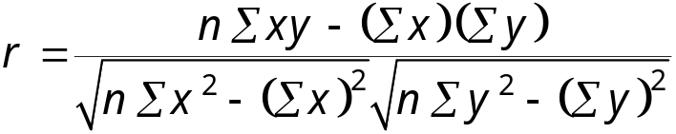
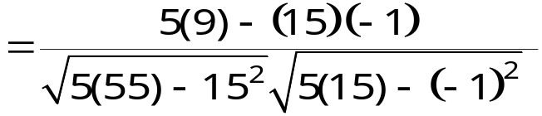
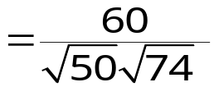

Correlation Coefficient
Example:
Calculate the correlation coefficient r for the following data.
x | y | xy | x² | y²
1 | – 3 | – 3 | 1 | 9
2 | – 1 | – 2 | 4 | 1
3 | 0 | 0 | 9 | 0
4 | 1 | 4 | 16 | 1
5 | 2 | 10 | 25 | 4
There is a strong positive linear correlation between x and y.

Slide 9
Correlation Coefficient
Example:
The following data represents the number of hours 12 different students watched television during the weekend and the scores of each student who took a test the following Monday.
a.) Display the scatter plot.
b.) Calculate the correlation coefficient r.
Hours, x | 0 | 1 | 2 | 3 | 3 | 5 | 5 | 5 | 6 | 7 | 7 | 10
Test score, y | 96 | 85 | 82 | 74 | 95 | 68 | 76 | 84 | 58 | 65 | 75 | 50
Continued.

Slide 10
Correlation Coefficient
Example continued:
Hours, x | 0 | 1 | 2 | 3 | 3 | 5 | 5 | 5 | 6 | 7 | 7 | 10
Test score, y | 96 | 85 | 82 | 74 | 95 | 68 | 76 | 84 | 58 | 65 | 75 | 50
y
100
80
60
Test score
40
20
x
2
4
6
8
10
Hours watching TV
Continued.

Slide 11





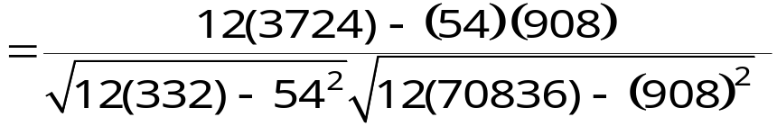

Correlation Coefficient
Example continued:
Hours, x | 0 | 1 | 2 | 3 | 3 | 5 | 5 | 5 | 6 | 7 | 7 | 10
Test score, y | 96 | 85 | 82 | 74 | 95 | 68 | 76 | 84 | 58 | 65 | 75 | 50
xy | 0 | 85 | 164 | 222 | 285 | 340 | 380 | 420 | 348 | 455 | 525 | 500
x² | 0 | 1 | 4 | 9 | 9 | 25 | 25 | 25 | 36 | 49 | 49 | 100
y² | 9216 | 7225 | 6724 | 5476 | 9025 | 4624 | 5776 | 7056 | 3364 | 4225 | 5625 | 2500
There is a strong negative linear correlation.
As the number of hours spent watching TV increases, the test scores tend to decrease.

Slide 12
Linear Regression

Slide 13
Residuals
After verifying that the linear correlation between two variables is significant, next we determine the equation of the line that can be used to predict the value of y for a given value of x.
y
Observed y-value
d₂
For a given x-value,
d = (observed y-value) – (predicted y-value)
d₁
Predicted y-value
d₃
x
Each data point d_{i} represents the difference between the observed y-value and the predicted y-value for a given x-value on the line. These differences are called residuals.

Slide 14
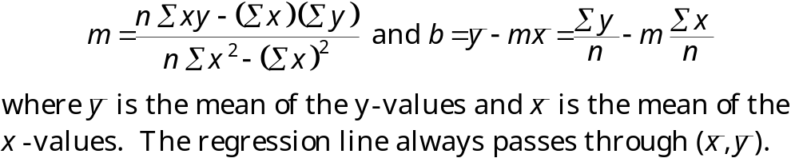
Regression Line
A regression line, also called a line of best fit, is the line for which the sum of the squares of the residuals is a minimum.
The Equation of a Regression Line
The equation of a regression line for an independent variable x and a dependent variable y is
ŷ = mx + b
where ŷ is the predicted y-value for a given x-value. The slope m and y-intercept b are given by

Slide 15
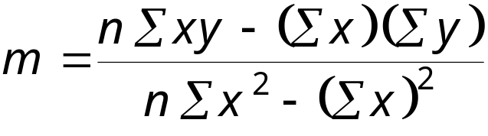
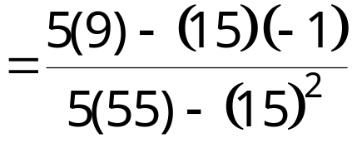
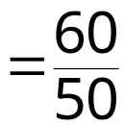

Regression Line
Example:
Find the equation of the regression line.
x | y | xy | x² | y²
1 | – 3 | – 3 | 1 | 9
2 | – 1 | – 2 | 4 | 1
3 | 0 | 0 | 9 | 0
4 | 1 | 4 | 16 | 1
5 | 2 | 10 | 25 | 4
Continued.

Slide 16
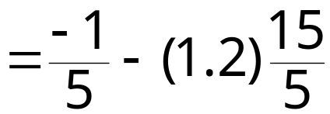


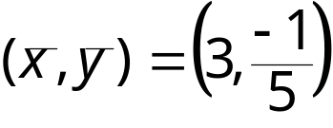
Regression Line
Example continued:
The equation of the regression line is
ŷ = 1.2x – 3.8.
y
2
1
x
−1
1
2
3
4
5
−2
−3

Slide 17
Regression Line
Example:
The following data represents the number of hours 12 different students watched television during the weekend and the scores of each student who took a test the following Monday.
a.) Find the equation of the regression line.
b.) Use the equation to find the expected test score for a student who watches 9 hours of TV.
Hours, x | 0 | 1 | 2 | 3 | 3 | 5 | 5 | 5 | 6 | 7 | 7 | 10
Test score, y | 96 | 85 | 82 | 74 | 95 | 68 | 76 | 84 | 58 | 65 | 75 | 50
xy | 0 | 85 | 164 | 222 | 285 | 340 | 380 | 420 | 348 | 455 | 525 | 500
x² | 0 | 1 | 4 | 9 | 9 | 25 | 25 | 25 | 36 | 49 | 49 | 100
y² | 9216 | 7225 | 6724 | 5476 | 9025 | 4624 | 5776 | 7056 | 3364 | 4225 | 5625 | 2500

Slide 18
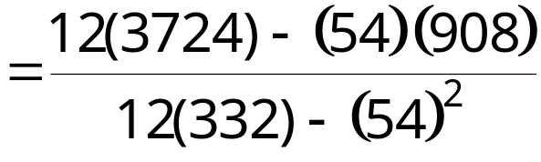

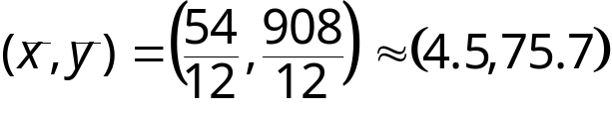
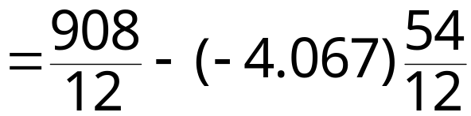

Regression Line
Example continued:
y
100
80
60
Test score
40
ŷ = –4.07x + 93.97
20
x
2
4
6
8
10
Hours watching TV
Continued.

Slide 19
Regression Line
Example continued:
Using the equation ŷ = –4.07x + 93.97, we can predict the test score for a student who watches 9 hours of TV.
ŷ = –4.07x + 93.97
= –4.07(9) + 93.97
= 57.34
A student who watches 9 hours of TV over the weekend can expect to receive about a 57.34 on Monday’s test.

Slide 20
Multiple Regression Equation
In many instances, a better prediction can be found for a dependent (response) variable by using more than one independent (explanatory) variable.
For example, a more accurate prediction of Monday’s test grade from the previous section might be made by considering the number of other classes a student is taking as well as the student’s previous knowledge of the test material.
A multiple regression equation has the form
ŷ = b + m₁x₁ + m₂x₂ + m₃x₃ + … + m_{k}x_{k}
where x₁, x₂, x₃,…, x_{k} are independent variables, b is the y-intercept, and y is the dependent variable.
* Because the mathematics associated with this concept is complicated, technology is generally used to calculate the multiple regression equation.

Slide 21
Predicting y-Values
After finding the equation of the multiple regression line, you can use the equation to predict y-values over the range of the data.
Example:
The following multiple regression equation can be used to predict the annual U.S. rice yield (in pounds).
ŷ = 859 + 5.76x₁ + 3.82x₂
where x₁ is the number of acres planted (in thousands), and x₂ is the number of acres harvested (in thousands). (Source: U.S. National Agricultural Statistics Service)
a.) Predict the annual rice yield when x₁ = 2758, and x₂ = 2714.
b.) Predict the annual rice yield when x₁ = 3581, and x₂ = 3021.
Continued.

Slide 22
Predicting y-Values
Example continued:
a.) ŷ = 859 + 5.76x₁ + 3.82x₂
= 859 + 5.76(2758) + 3.82(2714)
= 27,112.56
The predicted annual rice yield is 27,1125.56 pounds.
b.) ŷ = 859 + 5.76x₁ + 3.82x₂
= 859 + 5.76(3581) + 3.82(3021)
= 33,025.78
The predicted annual rice yield is 33,025.78 pounds.

